Slide 1
CPSC331 - Spring 2019 Tutorial 15
Khobaib Zaamout

Slide 2
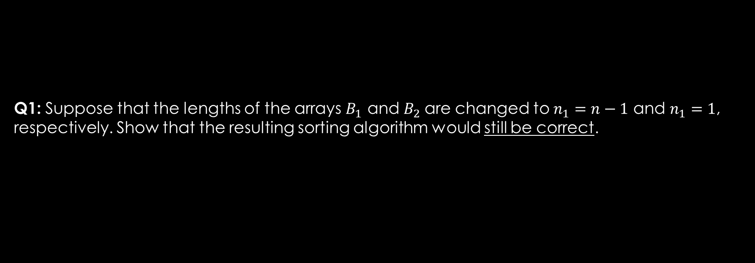
Q1: Show the algorithm is still correct
Q1: Suppose that the lengths of the arrays $B_{1}$ and $B_{2}$are changed to $n_{1}=n−1$ and $n_{1}=1$, respectively. Show that the resulting sorting algorithm would still be correct.

Slide 3
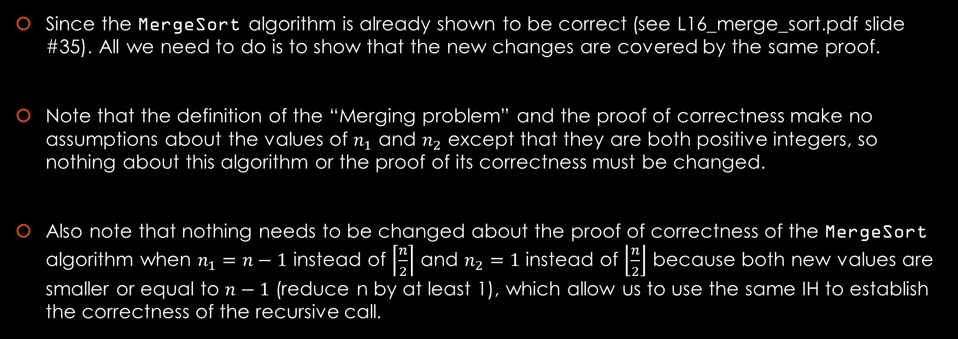
Q1: Show the algorithm is still correct
Since the MergeSort algorithm is already shown to be correct (see L16_merge_sort.pdf slide #35). All we need to do is to show that the new changes are covered by the same proof.
Note that the definition of the “Merging problem” and the proof of correctness make no assumptions about the values of $n_{1}$ and $n_{2}$ except that they are both positive integers, so nothing about this algorithm or the proof of its correctness must be changed.
Also note that nothing needs to be changed about the proof of correctness of the MergeSort algorithm when $n_{1}=n−1$ instead of $\left\lceil \frac{n}{2}\right\rceil$ and $n_{2}=1$ instead of $\left\lfloor \frac{n}{2}\right\rfloor$ because both new values are smaller or equal to $n−1$ (reduce n by at least 1), which allow us to use the same IH to establish the correctness of the recursive call.

Slide 4
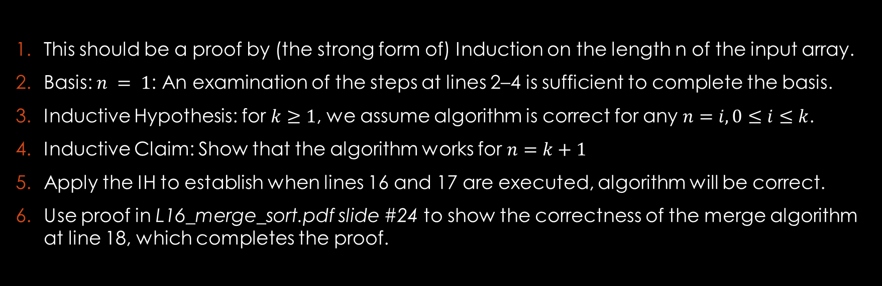
Q1: Show the algorithm is still correct
Answer:
This should be a proof by (the strong form of) Induction on the length n of the input array.
Basis: $n = 1$: An examination of the steps at lines 2–4 is sufficient to complete the basis.
Inductive Hypothesis: for $k≥1$, we assume algorithm is correct for any $n=i, 0≤i≤k$.
Inductive Claim: Show that the algorithm works for $n=k+1$
Apply the IH to establish when lines 16 and 17 are executed, algorithm will be correct.
Use proof in L16_merge_sort.pdf slide #24 to show the correctness of the merge algorithm at line 18, which completes the proof.

Slide 5
Q2: Write a recurrence for algorithm
Q2: Using the information about the worst case running time of the merge information in the online notes, write a recurrence that gives an upper bound for the number of steps used by this new version of the Merge Sort algorithm in the worst case.

Slide 6

Q2: Write a recurrence for algorithm
Note that the worst case running time of the merge is in slide #27 in L16_merge_sort.pdf is at most $5(n)+9$steps.

Slide 7

Q2: Write a recurrence for algorithm
Check n=1:
Lines 1-4 are executed and algorithm ends.
So, $T_{MergeSort}\left(1\right)=4$

Slide 8
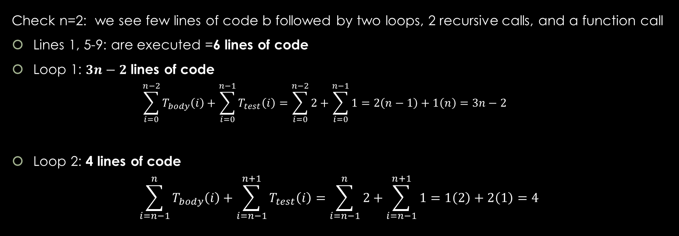
Q2: Write a recurrence for algorithm
Check n=2: we see few lines of code b followed by two loops, 2 recursive calls, and a function call
Lines 1, 5-9: are executed =6 lines of code
Loop 1: $3n−2$ lines of code
$$\sum_{i=0}^{n−2}{T_{body}\left(i\right)}+\sum_{i=0}^{n−1}{T_{test}\left(i\right)}=\sum_{i=0}^{n−2}{2}+\sum_{i=0}^{n−1}{1}=2\left(n−1\right)+1\left(n\right)=3n−2$$
Loop 2: 4 lines of code
$$\sum_{i=n−1}^{n}{T_{body}\left(i\right)}+\sum_{i=n−1}^{n+1}{T_{test}\left(i\right)}=\sum_{i=n−1}^{n}{2}+\sum_{i=n−1}^{n+1}{1}=1\left(2\right)+2\left(1\right)=4$$

Slide 9
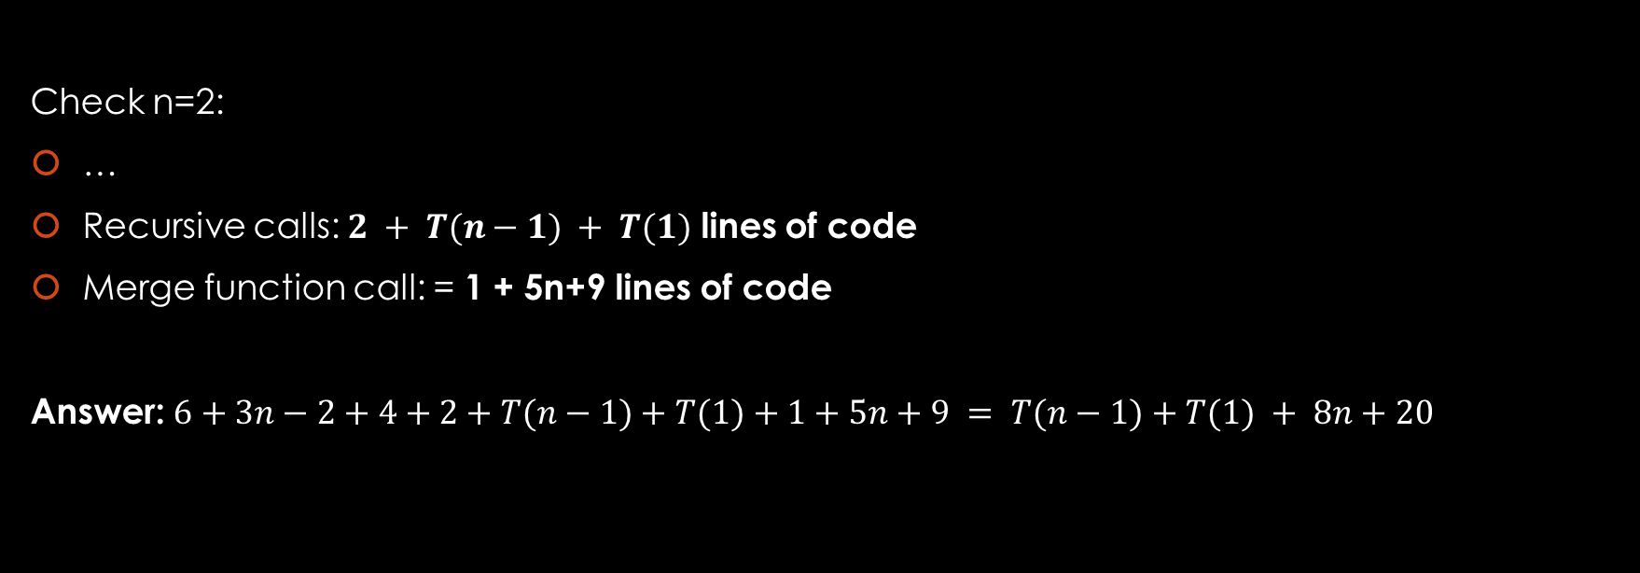
Q2: Write a recurrence for algorithm
Check n=2:
…
Recursive calls: $2 + T(n−1) + T(1)$ lines of code
Merge function call: = 1 + 5n+9 lines of code
Answer: $6+3n−2+4+2+T(n−1)+T(1)+1+5n+9 = T(n−1)+T(1) + 8n+20$

Slide 10

Q2: Write a recurrence for algorithm
Therefore,
$$T_{MergeSort}\left(n\right)≤\left\{\begin{aligned}4, if n=1, \\ T_{MergeSort}\left(n−1\right)+T_{MergeSort}\left(1\right)+8n+20&, if n≥2\end{aligned}\right.$$

Slide 11
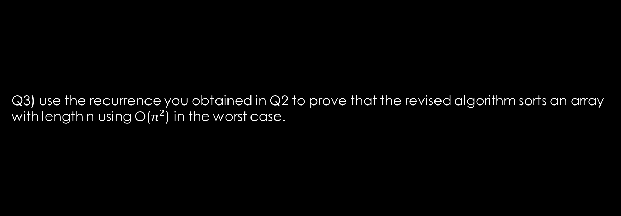
Q3: Write a recurrence for algorithm
Q3) use the recurrence you obtained in Q2 to prove that the revised algorithm sorts an array with length n using O($n^{2}$) in the worst case.

Slide 12
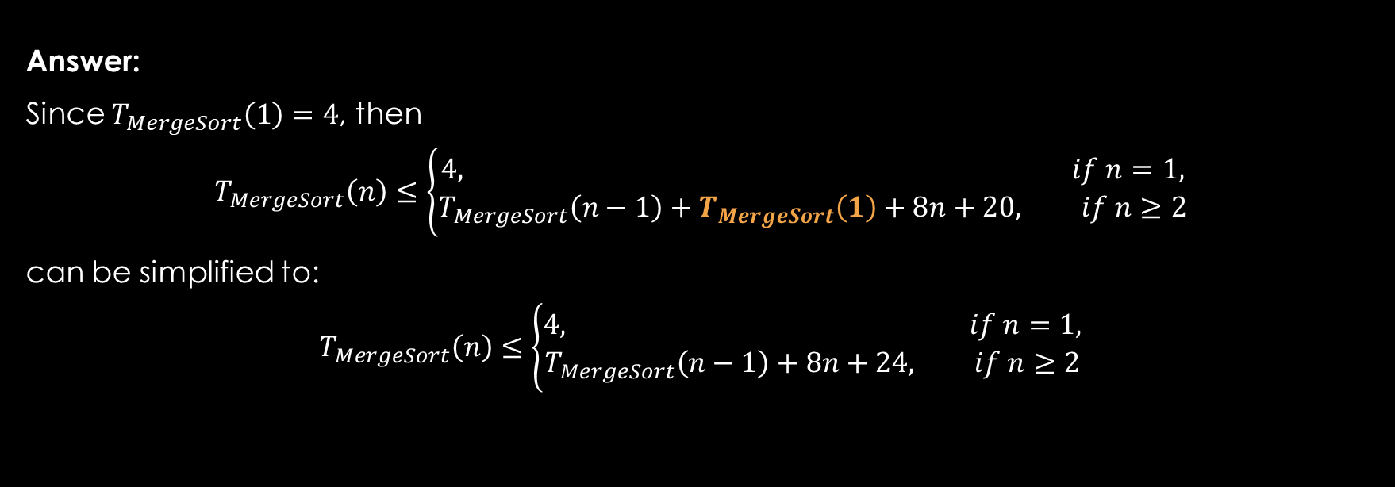
Q3: Write a recurrence for algorithm
Answer:
Since $T_{MergeSort}\left(1\right)=4$, then
$$T_{MergeSort}\left(n\right)≤\left\{\begin{aligned}4, if n=1, \\ T_{MergeSort}\left(n−1\right)+T_{MergeSort}\left(1\right)+8n+20&, if n≥2\end{aligned}\right.$$
can be simplified to:
$$T_{MergeSort}\left(n\right)≤\left\{\begin{aligned}4, if n=1, \\ T_{MergeSort}\left(n−1\right)+8n+24&, if n≥2\end{aligned}\right.$$

Slide 13
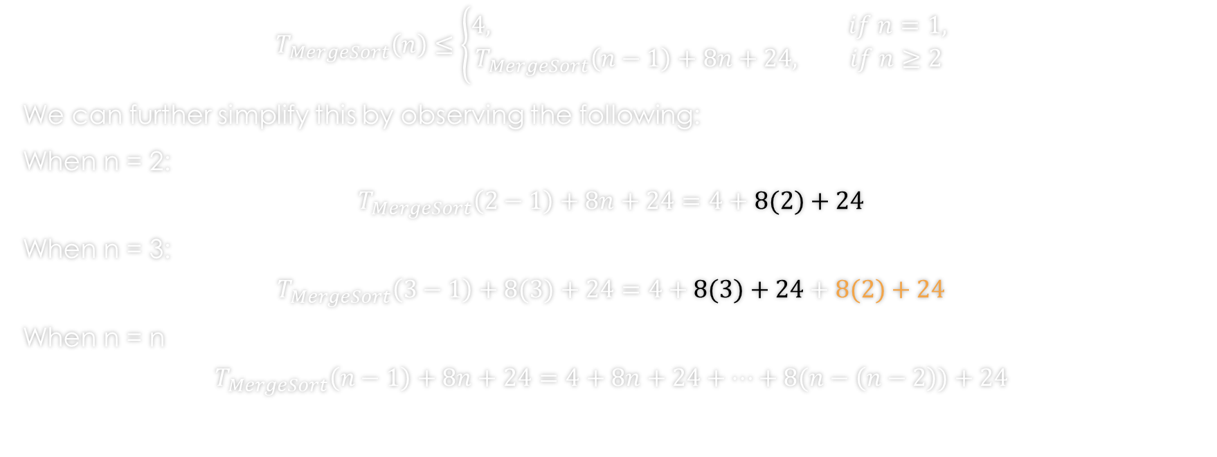
Q3: Write a recurrence for algorithm
$$T_{MergeSort}\left(n\right)≤\left\{\begin{aligned}4, if n=1, \\ T_{MergeSort}\left(n−1\right)+8n+24&, if n≥2\end{aligned}\right.$$
We can further simplify this by observing the following:
When n = 2:
$$T_{MergeSort}\left(2−1\right)+8n+24=4+8(2)+24$$
When n = 3:
$$T_{MergeSort}\left(3−1\right)+8(3)+24=4+8(3)+24+8(2)+24$$
When n = n
$$T_{MergeSort}\left(n−1\right)+8n+24=4+8n+24+…+8(n−\left(n−2\right))+24$$
n-2 times

Slide 14

Q3: Write a recurrence for algorithm
When n = n
$$T_{MergeSort}\left(n−1\right)+8n+24=4+8n+24+…+8(n−\left(n−2\right))+24$$
n-2 times
This is equivalent to:
$$T_{MergeSort(n)}≤4+\sum_{i=2}^{n}{(8i+24)}$$
for every positive integer n
Now, we can prove this using induction on n.
The core of the proof will be as follows:

Slide 15

Q3: Write a recurrence for algorithm
$$T_{MergeSort(n)}≤4+\sum_{i=2}^{n}{\left(8i+24\right)} \\ =4+\sum_{i=2}^{n}{(8i)+\sum_{i=2}^{n}{(24)}}$$
$$=4+8\sum_{i=1}^{n}{(i−8)+24\sum_{i=2}^{n}{(1)}} \\ =4+8\frac{n(n+1)}{2}−8+24\left(n−1\right) \\ =4+4n^{2}+4n−8+24n−24 \\ =4n^{2}+28n−28∈O(n^{2})$$

Slide 16
Q4: Write a recurrence for algorithm
Q4) Use the information about the best case running time to write a recurrence that gives a lower bound for the number of steps used by the revised algorithm, to sort an array with length n, in the best case.

Slide 17

Q4: Write a recurrence for algorithm
Note that the best case running time of the merge is in slide #27 in L16_merge_sort.pdf is at most $4(n)+10$steps.

Slide 18
Q4: Write a recurrence for algorithm
Check n=1:
Lines 1-4 are executed and algorithm ends.
So, $T_{MergeSort}\left(1\right)=4$

Slide 19
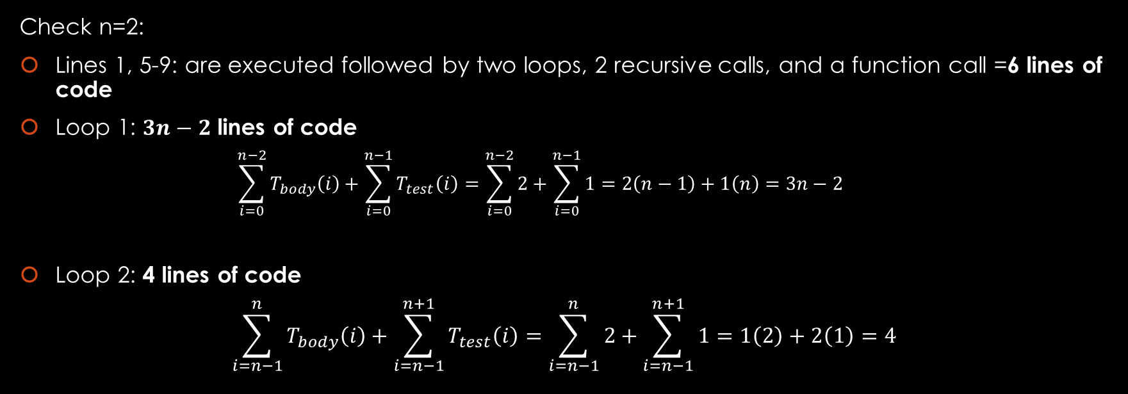
Q4: Write a recurrence for algorithm
Check n=2:
Lines 1, 5-9: are executed followed by two loops, 2 recursive calls, and a function call =6 lines of code
Loop 1: $3n−2$ lines of code
$$\sum_{i=0}^{n−2}{T_{body}\left(i\right)}+\sum_{i=0}^{n−1}{T_{test}\left(i\right)}=\sum_{i=0}^{n−2}{2}+\sum_{i=0}^{n−1}{1}=2\left(n−1\right)+1\left(n\right)=3n−2$$
Loop 2: 4 lines of code
$$\sum_{i=n−1}^{n}{T_{body}\left(i\right)}+\sum_{i=n−1}^{n+1}{T_{test}\left(i\right)}=\sum_{i=n−1}^{n}{2}+\sum_{i=n−1}^{n+1}{1}=1\left(2\right)+2\left(1\right)=4$$

Slide 20
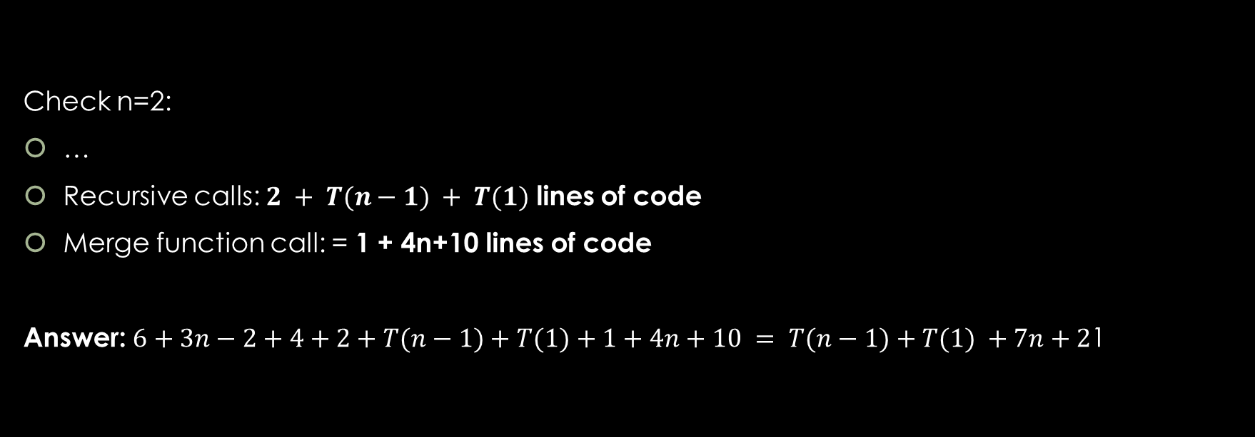
Q4: Write a recurrence for algorithm
Check n=2:
…
Recursive calls: $2 + T(n−1) + T(1)$ lines of code
Merge function call: = 1 + 4n+10 lines of code
Answer: $6+3n−2+4+2+T(n−1)+T(1)+1+4n+10 = T(n−1)+T(1) +7n+2$1

Slide 21

Q4: Write a recurrence for algorithm
Therefore,
$$T_{MergeSort}\left(n\right)≥\left\{\begin{aligned}4, if n=1, \\ T_{MergeSort}\left(n−1\right)+T_{MergeSort}\left(1\right)+7n+21&, if n≥2\end{aligned}\right.$$

